Slide 1
Toynbee Hall/Linkage
Team 12

Slide 2
Brainstorm
Profile
Register
Issues
Urgent?
Refer-ence
Submit
Langu-age

Slide 3



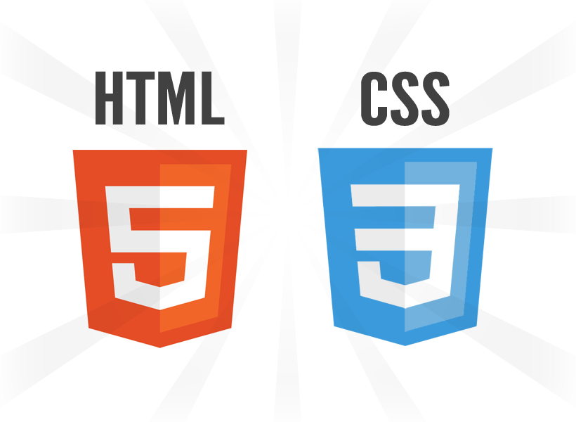

Technologies Used

Slide 4
Future Plans
Text to Speech Integration
Google Maps Integration
More translation options
Other Locations

